Slide 1
CSE 1100 Introduction to Computer Systems
MD. Milon ISLAM
Md. Masum Al Masba

Slide 2

CSE 1100
1
A bridge between higher secondary and bachelor level Computer Science courses
01/28/2020

Slide 3
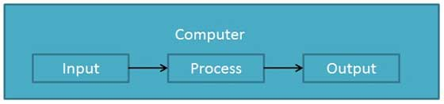
What Is a Computer?
1
Computer is an electronic data processing device which
accepts and stores data input,
processes the data input, and
generates the output in a required format.
What is computer literacy?
Knowledge and understanding of computers and their uses
01/28/2020

Slide 4
Schematic Diagram of a Personal Computer
1
Ports
bus
Printer
Mouse
Keyboard
Modem
Disk controller
Graphics card
Monitor
Speakers
CPU
Sound card
RAM
Network card
Computer
01/28/2020

Slide 5
Information processing cycle
1
Input
Process
Output
Storage
Communication
01/28/2020

Slide 6
The Components of a Computer
1
Hardware
the physical, tangible parts of a computer
keyboard, monitor,wires, chips
Hard disk, CD, DVD, RAM, Mother Board
Software
programs and data
a program is a series of instructions
A computer requires both hardware and software
Each is essentially useless without the other
01/28/2020

Slide 7
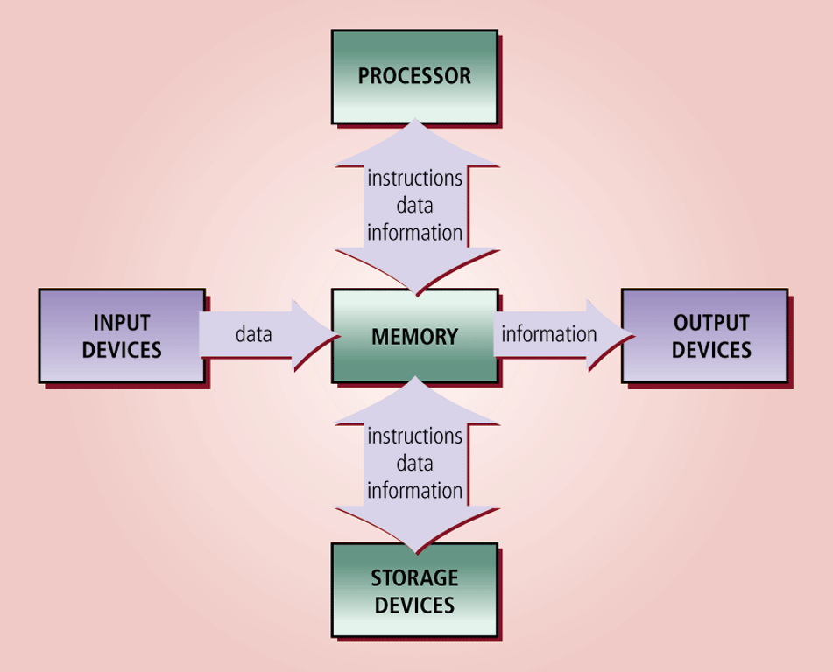
The Components of a Computer
1
01/28/2020

Slide 8
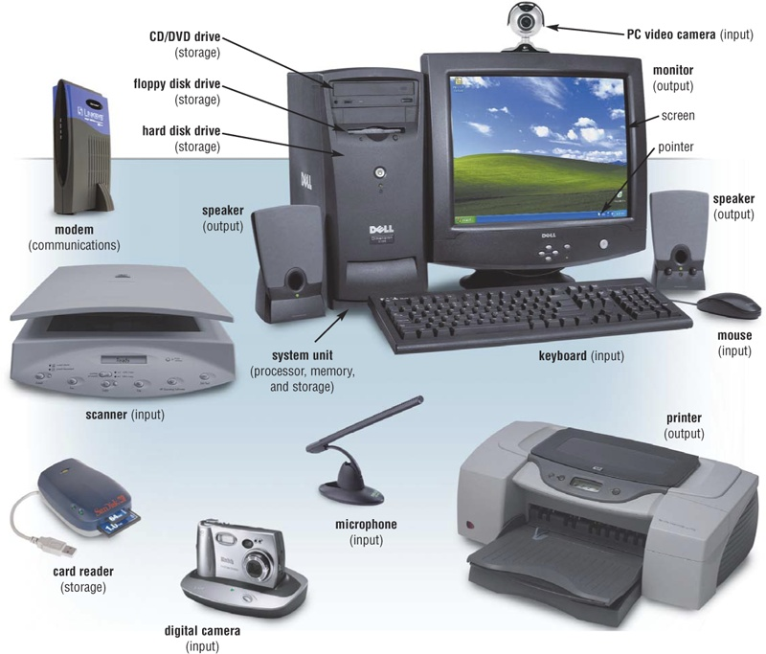
The Components of a Computer
1
Input device:
Hardware used
to enter data
and instructions
01/28/2020

Slide 9
The Components of a Computer
1
Output device Hardware that
conveys information to a user
01/28/2020

Slide 10
The Components of a Computer
1
System unit:
Box containing electronic components
used to process
data
01/28/2020

Slide 11
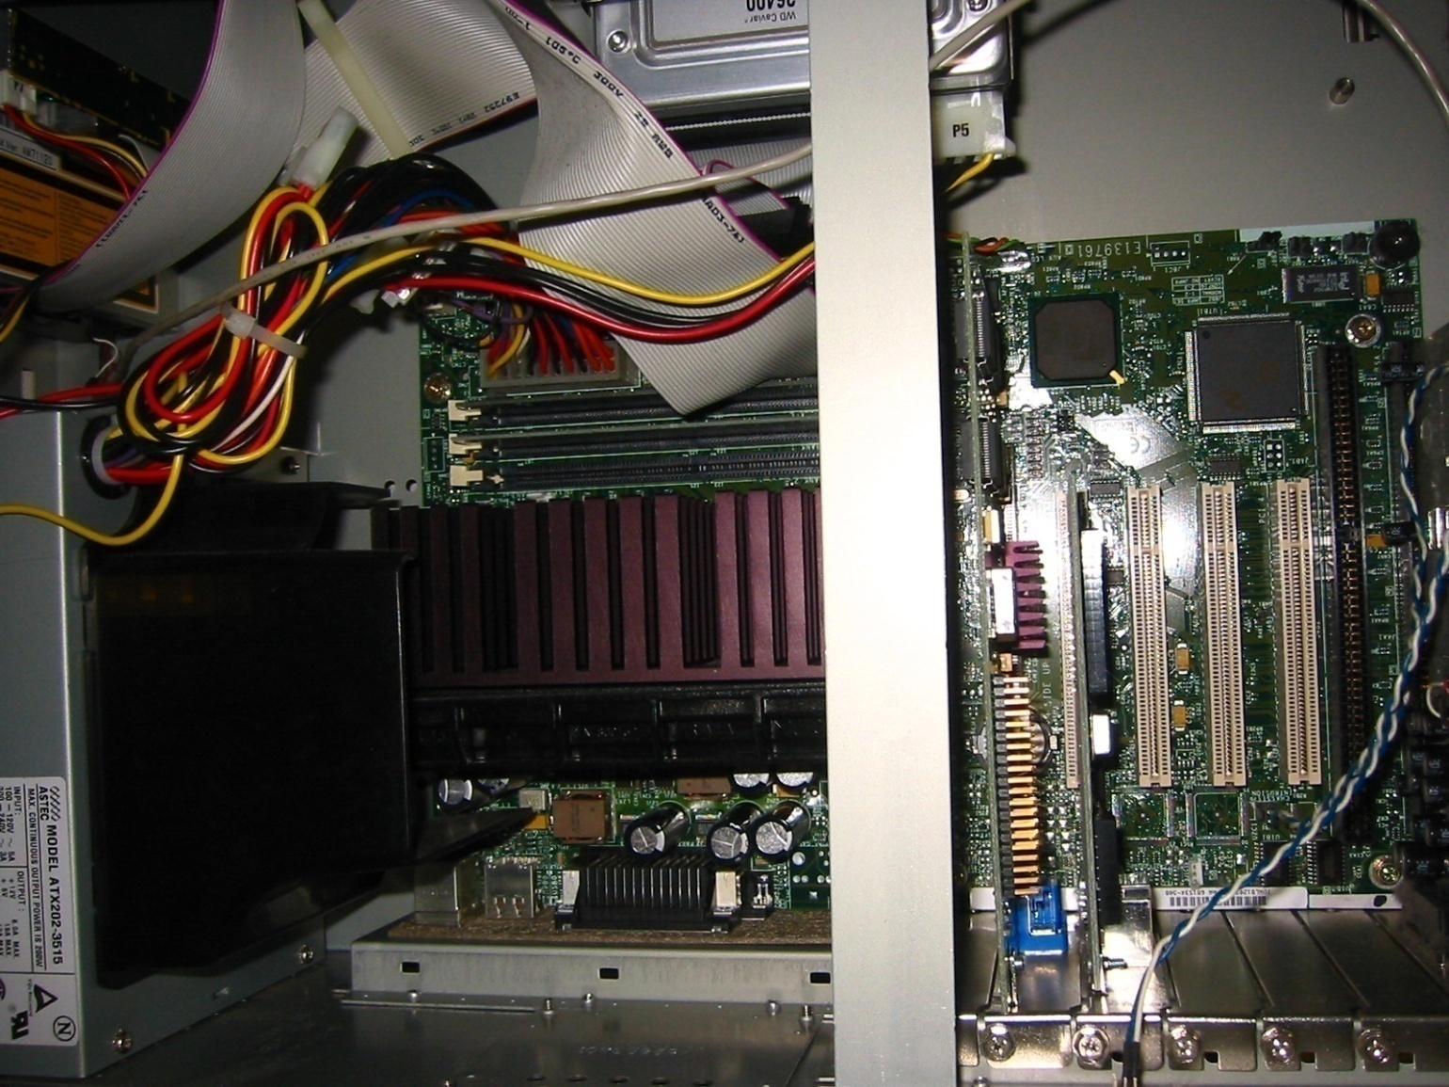
Inside the black box
Storage Units
1
Video Card
Memory card
CPU
Power
Supply
Sound Card
01/28/2020

Slide 12
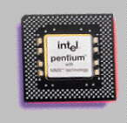
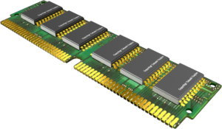
The Components of a Computer
What are two main components on the motherboard?
Central Processing Unit (CPU)
Also called a processor
Carries out instructions
that tell computer what to do
Memory
Temporary holding place for data
and instructions
01/28/2020

Slide 13
The Components of a Computer
1
What is storage?
Holds data, instructions, and information for future use
Storage media
Physical material on which data, instructions, and information are stored
Storage device
Records and retrieves items to and from a storage medium
01/28/2020

Slide 14
The Computer System
1
Computer system consists of :
central processing unit (CPU)
primary storage
secondary storage
input devices
output devices
Communications devices.
01/28/2020

Slide 15
Component of Computer Systems
1
Communication Devices
Secondary Storage
- Magnetic disk
Buses
Central Processing Unit (CPU)
Primary Storage
Input Devices
- Keyboard
Output Devices
- Printers
01/28/2020

Slide 16
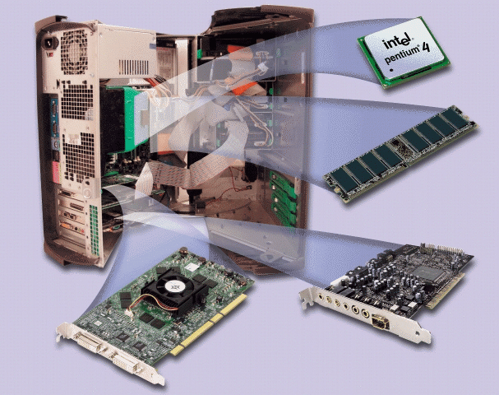
The System Unit
1
What are common components inside the system unit?
Processor
power supply
drive bays
Memory
Adapter cards
Sound card
Video card
Ports
Drive bays
Power supply
processor
ports
memory
video card
sound card
01/28/2020

Slide 17
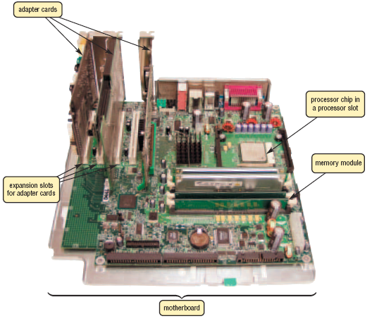
The System Unit
1
What is the motherboard
Main circuit board in system unit
Contains adapter cards, processor chips, and memory chips
Also called system board
01/28/2020

Slide 18
The System Unit
1
The CPU
manipulates raw data into more useful form and controls the other parts of the computer system.
Primary storage
temporarily stores data and program instructions during processing.
Secondary storage
devices store data and programs when they are not being used in processing.
01/28/2020

Slide 19
The System Unit
1
Input devices
convert data and instructions into electronic form for input into the computer.
Output devices
convert electronic data produced by the computer system and display them in a form that people can understand.
Communication devices
provide connections between the computer and communications networks.
Buses
are circuitry paths for transmitting data and signals among the parts of the computer system.
01/28/2020

Slide 20
Processor
1
What is the central processing unit (CPU)
Interprets and carries out basic instructions that operate a computer
Processor
Control Unit
Arithmetic Logic Unit (ALU)
Control Unit
Arithmetic Logic Unit (ALU)
Control unit directs and coordinates operations in computer
Instructions Data Information
Memory
Input Devices
Data
Information
Output Devices
Arithmetic logic unit (ALU) performs arithmetic, comparison, and logical operations
Instructions Data Information
Also called the processor
Storage Devices
01/28/2020

Slide 21
Data and Information
1
All computer processing requires data, which is a collection of
raw facts, figures and symbols,
such as numbers, words, images, video and sound, given to the computer during the input phase.
Computers manipulate data to create information. Information is data that is organized, meaningful, and useful.
During the output Phase, the information that has been created is put into some form, such as a printed report.
The information can also be put in computer storage for future use.
01/28/2020

Slide 22
Computer Software
1
Software, also called a program, consists of a series of related instructions, organized for a common purpose, that tells the computer what tasks to perform and how to perform them
Graphical user interface
Web application
System software consists of programs to control the operations of computer and its devices
Operating system
Utility program
01/28/2020

Slide 23
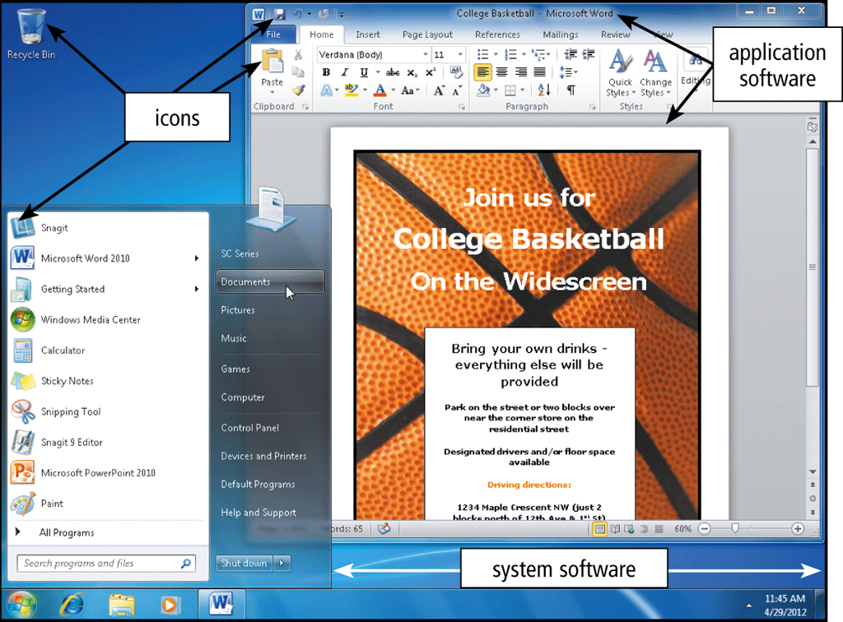
Computer Software
1

Slide 24
Computer Software
1
Application software consists of programs designed to make users more productive and/or assist them with personal tasks
Word processing
Presentation
Spreadsheet
Database
E-mail
01/28/2020

Slide 25
1
A Computer Specification
01/28/2020

Slide 26
Computer Performance
CPU speed (and type)
Amount of RAM (and speed)
Hard disk capacity (and speed)
Operating System used
01/28/2020
Notes:
1
1

Slide 27
Inside “The Box”

Slide 28
Let’s open the box!
1
Dr. Azhar, KUET.
01/28/2020
1
Notes:
<number>
1

Slide 29
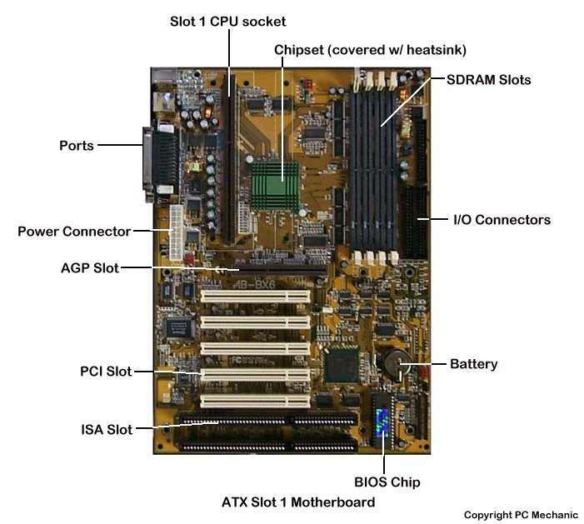
Draw the mother board and its components
1
Dr. Azhar, KUET.
01/28/2020
1
Notes:
<number>
1

Slide 30
1
Have nice time with computer
For
professional development!!
Dr. Azhar, KUET.
01/28/2020

